Slide 1
Parallel Programming Project
Parallel excution using processes and threads

Slide 2

Team members
Esraa Maged
Rahma Khaled
Rawda Essam
Habibah Mohammed
Sara Samir
Supervisor
Eng Gomaa ElMokhtar

Slide 3
Table of content
01
02
03
04
Introduction
A quick tour in the website
How to run
Streamlit library
Building a simple website using python
Multiprocessing
Performing parallel functions regarding a bank system
Threading
Performing parallel functions regarding a bank system

Slide 4
Members’ rules
Esraa Maged | Streamlit library and design, Code gathering, and implementation (Synchronization in threads).
Rahma Khaled | GUI Design, Code gathering, and implementation(Parallel execution and Synchronization in threads).
Rawda Essam | Code gathering and implementation(parallel execution in processes), GUI Design
Habiba Mohammed | GUI Design, Code gathering, and implementation(Communication using server process and queue).
Sara Samir | GUI Theme, Code gathering and implementation(Communication using server process), Presentation

Slide 5
01
Introduction

Slide 6
Introduction
Streamlit | Streamlit is an open-source Python library that enables rapid development of web applications with simple scripts, allowing data scientists to create interactive and shareable data-driven apps effortlessly.
MultiProcessing | is a programming paradigm that involves the simultaneous execution of multiple processes, allowing for better resource utilization and improved performance in parallel computing.
Threading | Threading in Python is a programming technique that allows concurrent execution of multiple tasks within the same program, enabling parallelism and improving the performance of applications by running tasks concurrently.
We are using the provided tools and concepts to implement parallel programming using python into a simple bank system.

Slide 7
App Screens Tour in the website

Slide 8
How to run
Visit this link and download the project code from github: codeLink
Open the main.py file on a python editor Pycharm is preferred
Type this command on the editor local terminal:
streamlit run main.py
The following app screens would be displayed

Slide 9
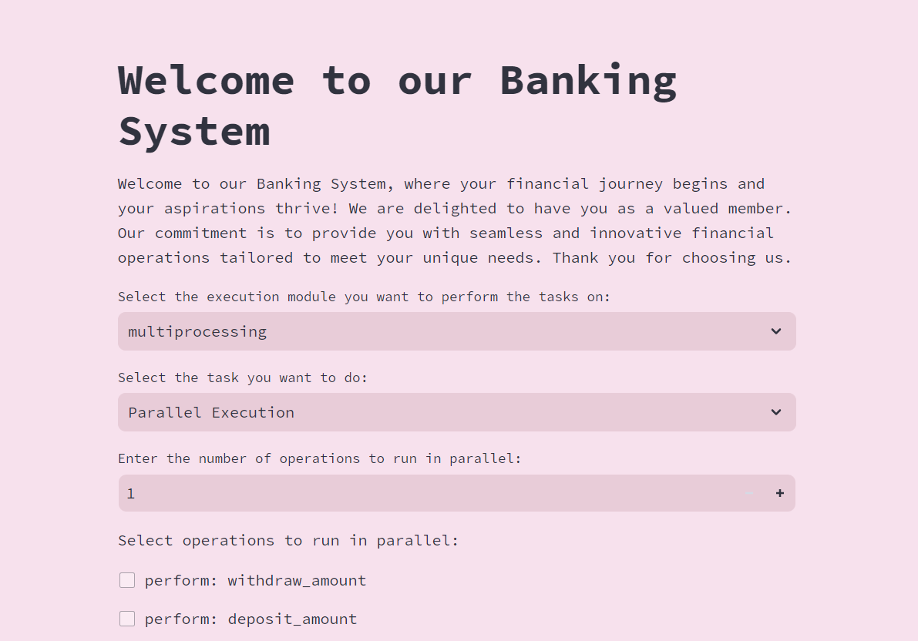

Slide 10
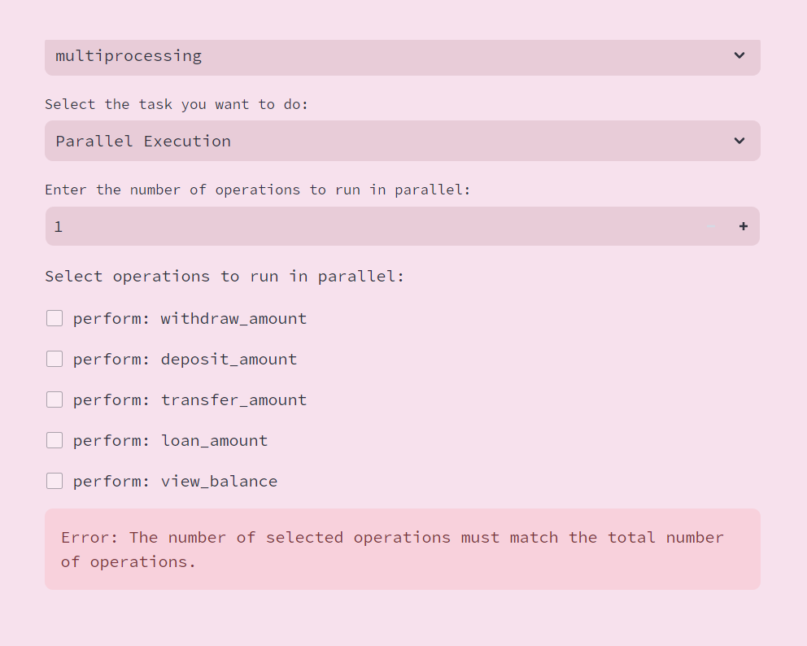

Slide 11
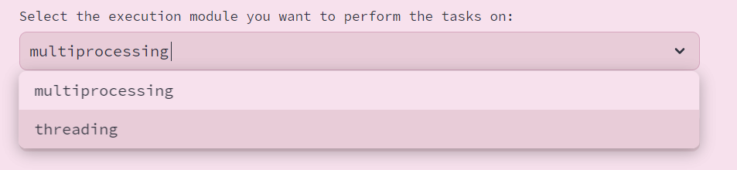
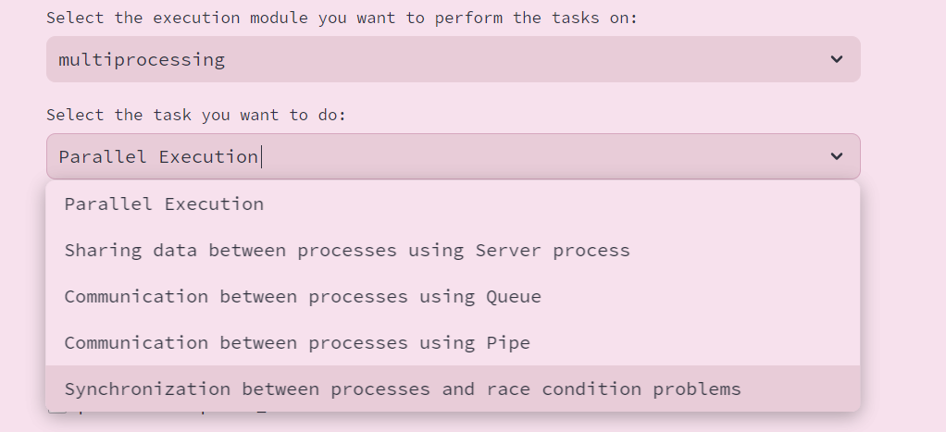

Slide 12
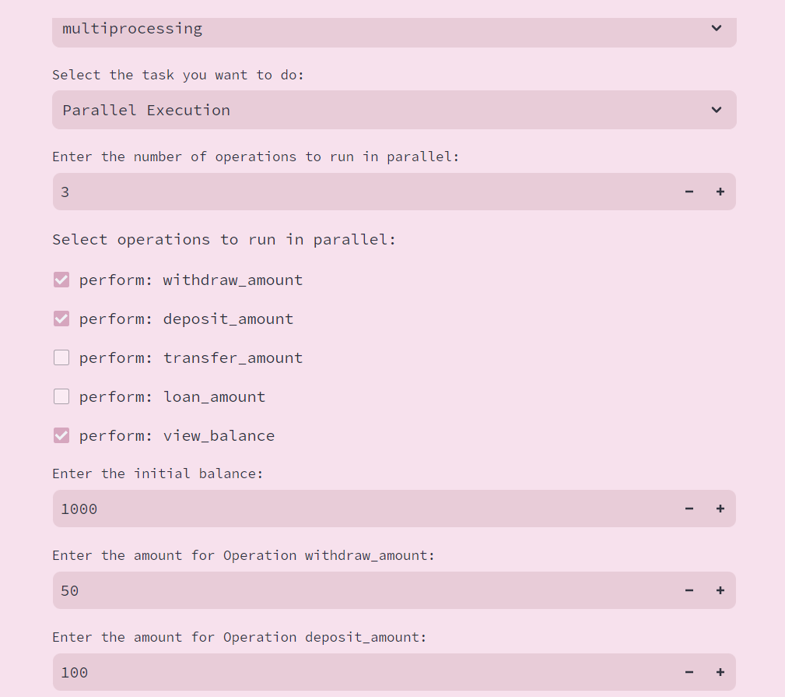
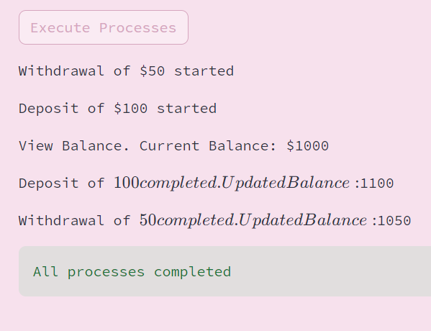
Operation
Output

Slide 13
02
Streamlit Library

Slide 14

Streamlit is an open-source Python library that is used to create web applications for data science and machine learning with minimal effort. It is designed to be simple and easy to use, allowing users to turn data scripts into shareable web apps in just a few lines of code.
Installation: pip install streamlit
Import: import streamlit as st
Writing: st.write(“parallel excution")
Title: st.title("Welcome to our Banking System")
Running: streamlit run app.py
Button: st.button("Execute Processes")

Slide 15
st.selectbox("Select the execution module you want to perform the tasks on:", ["multiprocessing", "threading"])
st.number_input("Enter the number of operations to run in parallel:", min_value=1, max_value=5, value=1, step=1)
st.checkbox(f"perform: {function_map[i].__name__}", key=f"func_checkbox_{i}")
st.error("Error: The number of selected operations must match the total number of operations.")
st.write("\nChoose operation:") st.write("1. Deposit") st.write("2. Withdraw")
st.success(f"The final balance after performing the operations: {balance.value}")
st.text_input("Enter your choice (1/2): ")
st.number_input("Enter the initial balance:", min_value=0, value=1000, step=1)

Slide 16
03
MultiProcessing

Slide 17
Main functions
def withdraw_amount(output_queue, balance, amount): output_queue.put(f"Withdrawal of ${amount} started") time.sleep(3) balance.value -= amount output_queue.put(f"Withdrawal of ${amount} completed. Updated Balance: ${balance.value}") def deposit_amount(output_queue, balance, amount): output_queue.put(f"Deposit of ${amount} started") time.sleep(2) balance.value += amount output_queue.put(f"Deposit of ${amount} completed. Updated Balance: ${balance.value}")
def transfer_amount(output_queue, balance, amount): output_queue.put(f"Transfer of ${amount} started") time.sleep(4) balance.value -= amount # Assuming transfer is a withdrawal output_queue.put(f"Transfer of ${amount} completed. Updated Balance: ${balance.value}") def loan_amount(output_queue, balance, amount): output_queue.put(f"Loan application for ${amount} started") time.sleep(1) balance.value += amount output_queue.put(f"Loan application for ${amount} completed. Updated Balance: ${balance.value}") def view_balance(output_queue, balance): output_queue.put(f"View Balance. Current Balance: ${balance.value}")

Slide 18
The provided code defines five main functions for our banking system:
1. Withdraw amount(output queue, balance, amount):
- Initiates a withdrawal operation with a specified amount.
- Simulates the withdrawal process with a sleep of 3 seconds.
- Updates the user's balance by deducting the withdrawal amount.
- Outputs messages indicating the start, completion, and updated balance to the output queue.
2. Deposit amount(output queue, balance, amount):
- Initiates a deposit operation with a specified amount.
- Simulates the deposit process with a sleep of 2 seconds.
- Updates the user's balance by adding the deposit amount.
- Outputs messages indicating the start, completion, and updated balance to the output queue.

Slide 19
The provided code defines five main functions for our banking system:
4. Loan amount(output queue, balance, amount):
- Initiates a loan application with a specified amount.
- Simulates the loan application process with a sleep of 1 second.
- Updates the user's balance by adding the loan amount.
- Outputs messages indicating the start, completion, and updated balance to the output queue.
5. View balance(output queue, balance):
- Provides the user with the current balance information.
- Outputs a message indicating the current balance to the output queue.
3. Transfer amount(output queue, balance, amount):
- Initiates a transfer operation with a specified amount (treated as a withdrawal).
- Simulates the transfer process with a sleep of 4 seconds.
- Updates the user's balance by deducting the transfer amount.
- Outputs messages indicating the start, completion, and updated balance to the output queue.

Slide 20
process = multiprocessing.Process(target=function_map[function_id], args=(output_queue, balance, amount))
process = multiprocessing.Process(target=function_map[function_id], args=(output_queue, balance))
Creating processes
if st.button("Execute Processes"): # Start threads for process in processes: process.start() # Wait for threads to finish for process in processes: process.join() # Check if there are additional messages in the queue try: while True: output = output_queue.get_nowait() st.write(output) except queue.Empty: pass # Display success message st.success("All processes completed")
Executing processes
Note the same five functions is used for both processes and threads

Slide 21
Depending on these five functions we are performing the following operations:
Parallel Execution: for executing these five functions in parallel using the multiprocessing module.
Sharing data between processes using Server process.
Communication between processes using Queue.
Communication between processes using Pipe.
Synchronization between threads and race condition problems.

Slide 22
Code for each operation

Slide 23
04
Threading

Slide 24
thread = threading.Thread(target=function_map[function_id], args=(output_queue, balance, amount))
thread = threading.Thread(target=function_map[function_id], args=(output_queue, balance))
Creating threads
if st.button("Execute Processes"): # Start threads for thread in threads: thread.start() # Wait for threads to finish for thread in threads: thread.join() # Check if there are additional messages in the queue try: while True: output = output_queue.get_nowait() st.write(output) except queue.Empty: pass # Display success message st.success("All threads completed")
Executing threads
Note the same five functions is used for both processes and threads

Slide 25
Thanks!
Any Questions?

